Slide 1
Citi HackOverflow
Team Aether
Investing Early = Compound Yum Yums

Slide 2
IMPORTANCE OF FINANCIAL EDUCATION
BUSINESS SOLUTION
Early Investing, financial discipline etc
How we plan to capture young/budding investors
FEAR OF TAKING THE FIRST STEP
TECHNICAL SOLUTION
Why it is the first question financial institutions need to address
Modular, POC driven Architecture. Made with ReactJS, ExpressJS, NodeJS and AWS Serverless Cloud
GEN Y/Z MARKET
The untapped market up for grabs

Slide 3
GEN Z
"(Gen Z youth) do set life goals - they tend to be more open to setting a goal and then saving up for it. And because they do that, the question then comes to invest the savings."
Freddy Lim, CIO, Stashaway
Most risk averse age group
Smallest portion of portfolio invested in riskier financial instruments
Futu Holdings, 2022
*percentage change from 31st December 2021 to 15th June 2022
10.08%
20.16%
Decrease in equity allocation
Increase in fund allocation

Slide 4
GEN Z
WILLING
BUT
Lack investment capital
Make investment decisions based on popular trends
Lack a fundamental understanding on investing
Hesitation in placing trust towards financial institution
Want to invest
Don't know how to
Don't know enough
Don't Enter
Exit early

Slide 5
Financial education
Low cost avenue to take risks

Slide 6
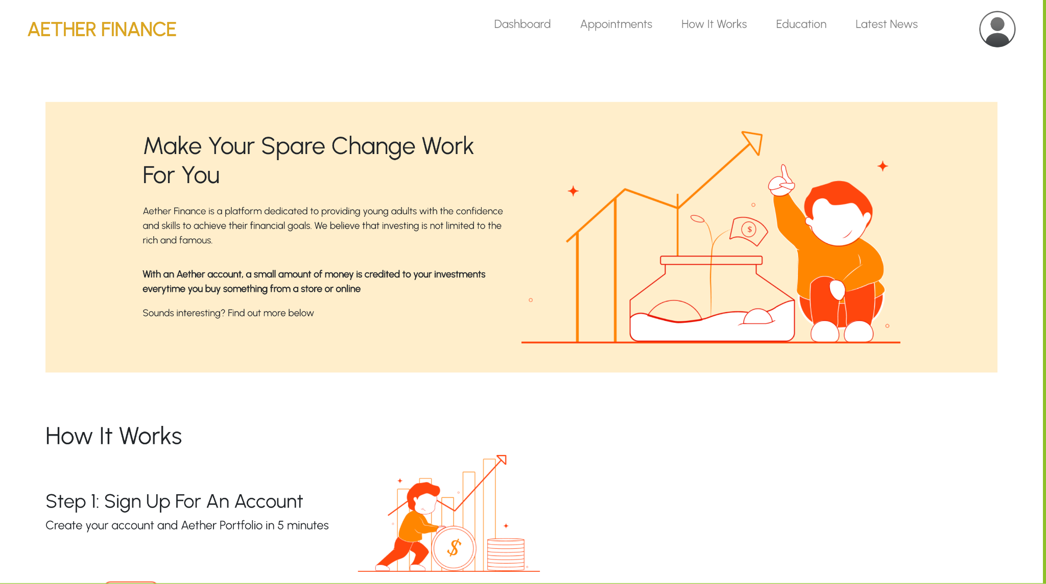

Slide 7

INVEST AS YOU SPEND
Every payment you make is rounded to the nearest dollar (or two).
This is added to your Aether Investment Portfolio

Slide 8
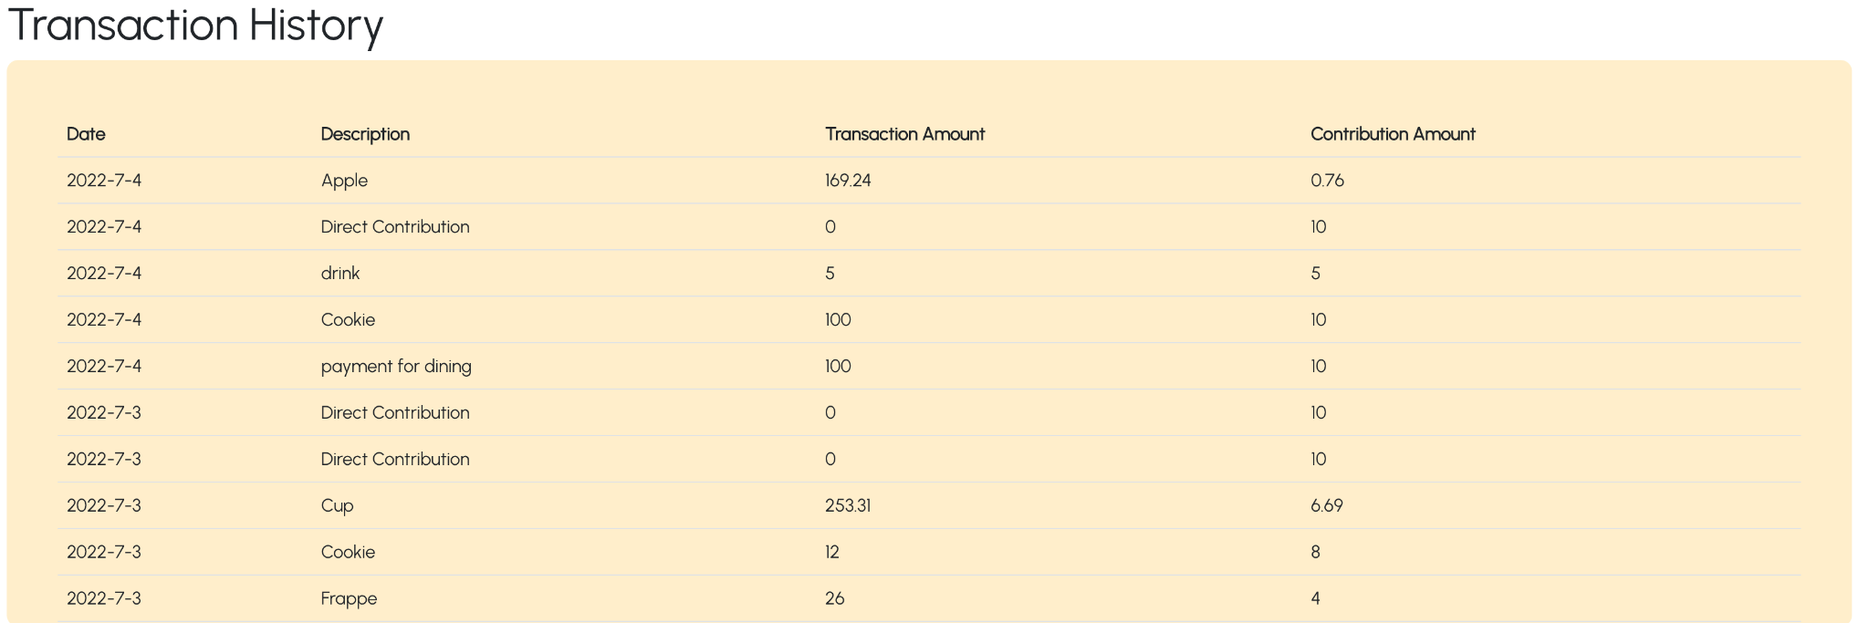

Slide 9

WELL OF FINANCIAL KNOWLEDGE
Gain access to seminars, curated news content and even book a consultation with our Financial Experts

Slide 10
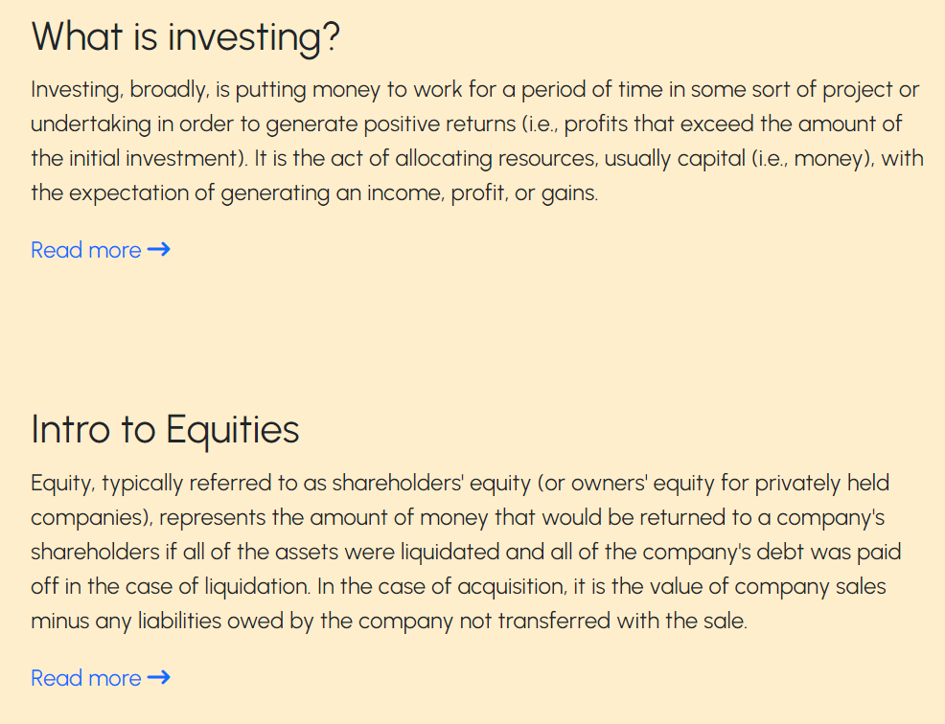
EDUCATIONAL ARTICLES

Slide 11
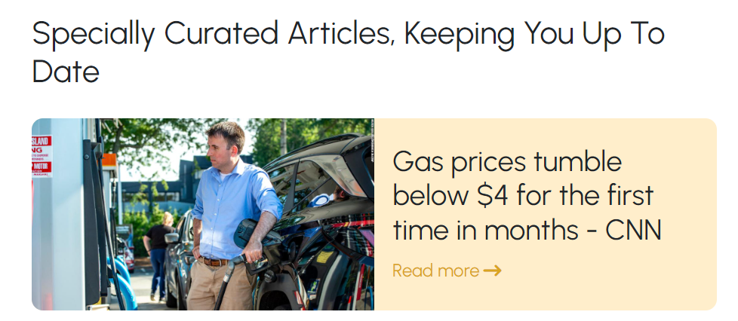
LATEST NEWS

Slide 12


HUMAN TOUCHÉ & RETURN TRAFFIC

Slide 13
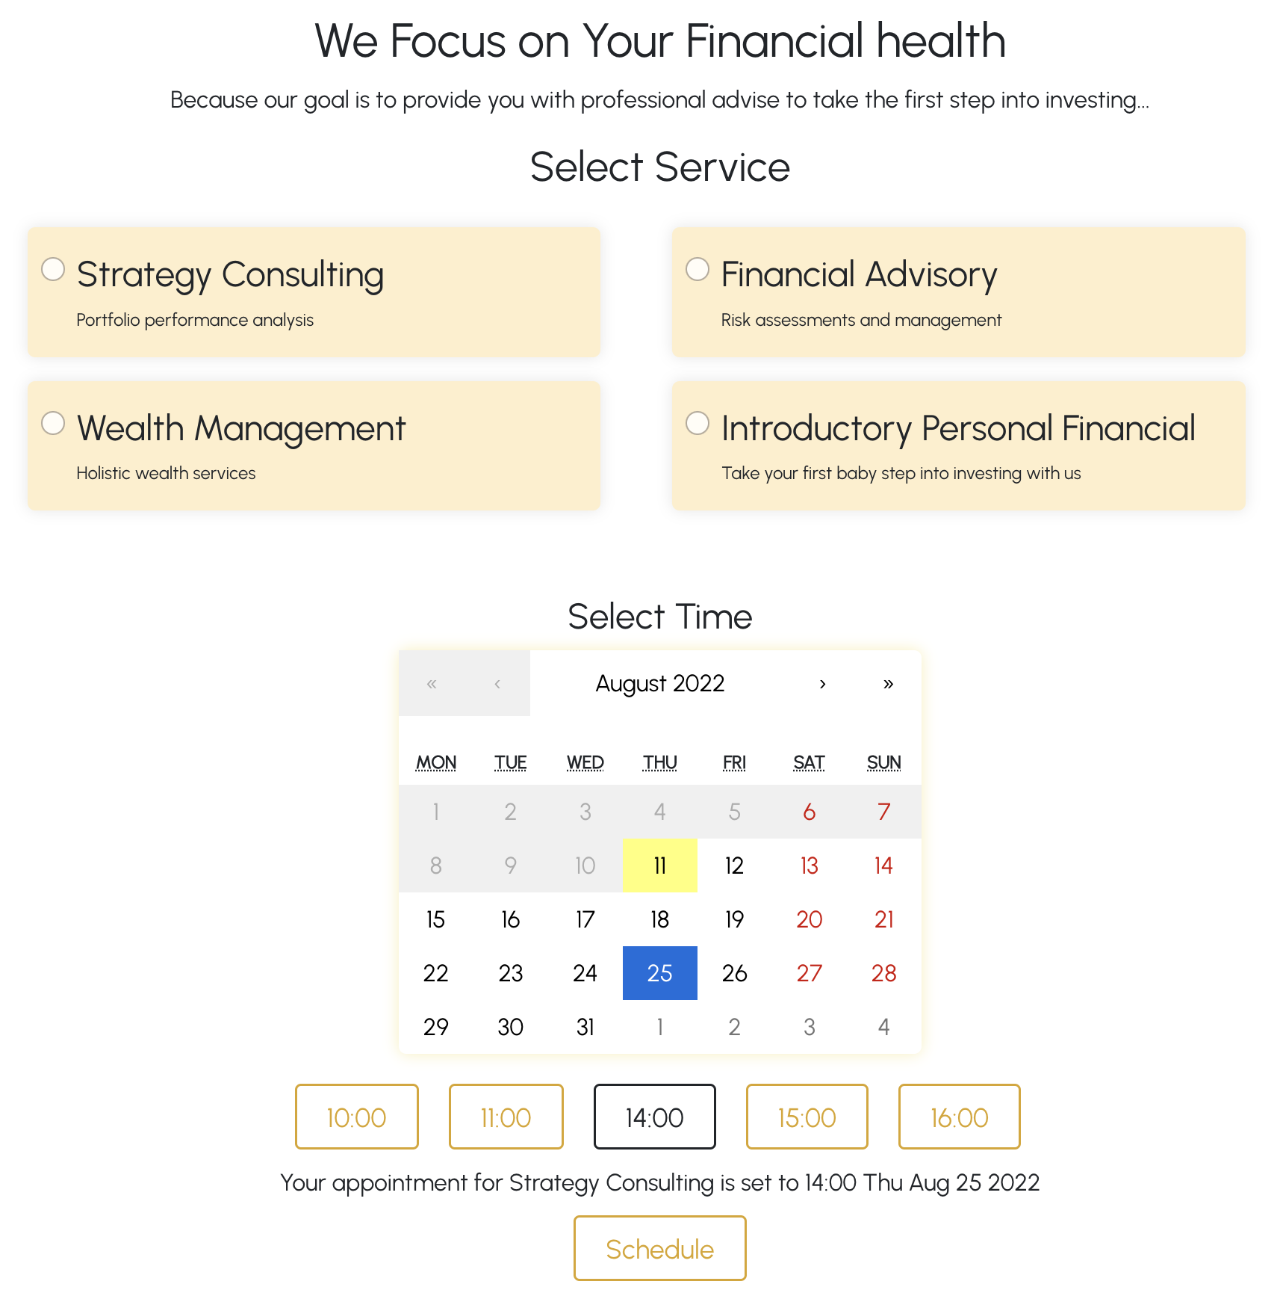

Slide 14
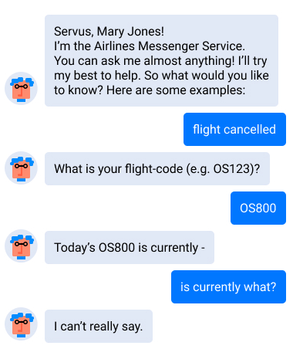
GOOD PRODUCT, LOW ADOPTION

Slide 15

BE IN CONTROL
Important financial metrics delivered through easy-to-understand charts and tables

Slide 16
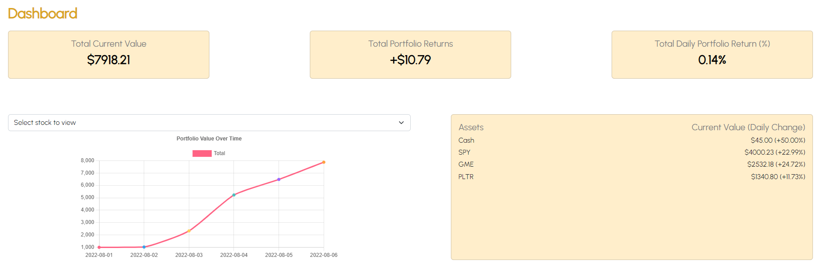
LIVE DASHBOARD

Slide 17
BUILD UP CYCLE
Financial Education
Market Exposure
Investments
Notes:
This cycle goes hand in hand with the 2 primary issues that we are addressing

Slide 18
Tech Stack
MODULAR
APIs for data processing
WEB APP
NoSQL DATABASE
ReactJS, NodeJS, ExpressJS
Development friendly especially in POC settings
CLOUD
SERVERLESS FRAMEWORK
Amplify
API Gateway,
Lambda, DynamoDB
Efficiently provision and scale cloud infrastructure

Slide 19
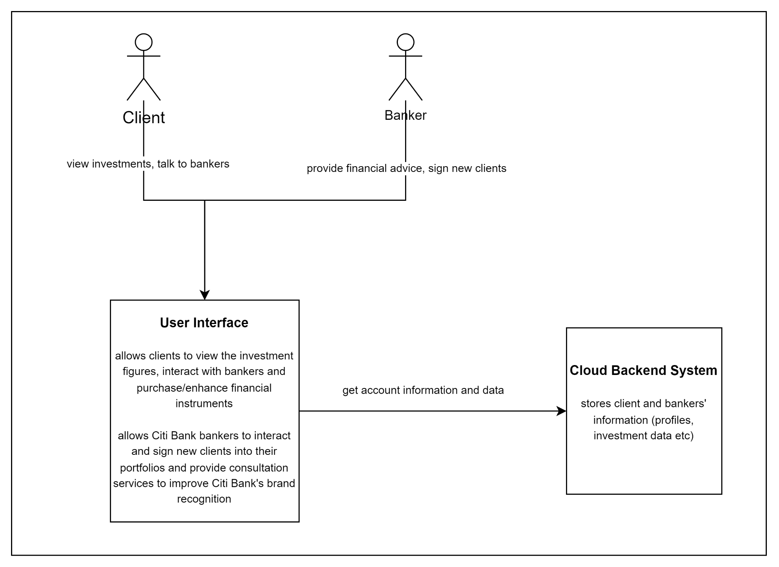
Context Diagram

Slide 20
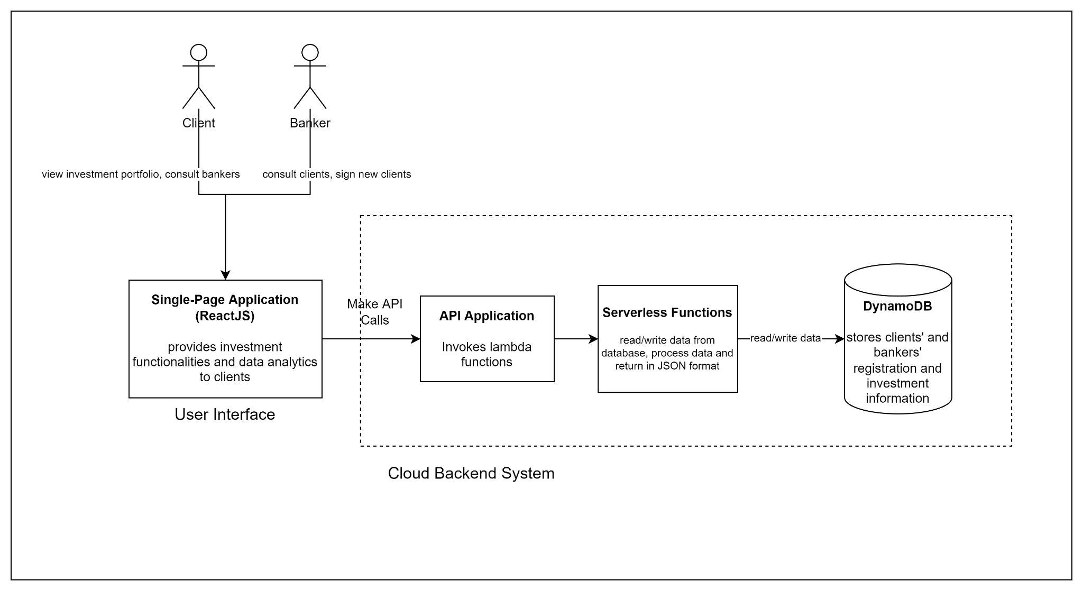
Container Diagram

Slide 21
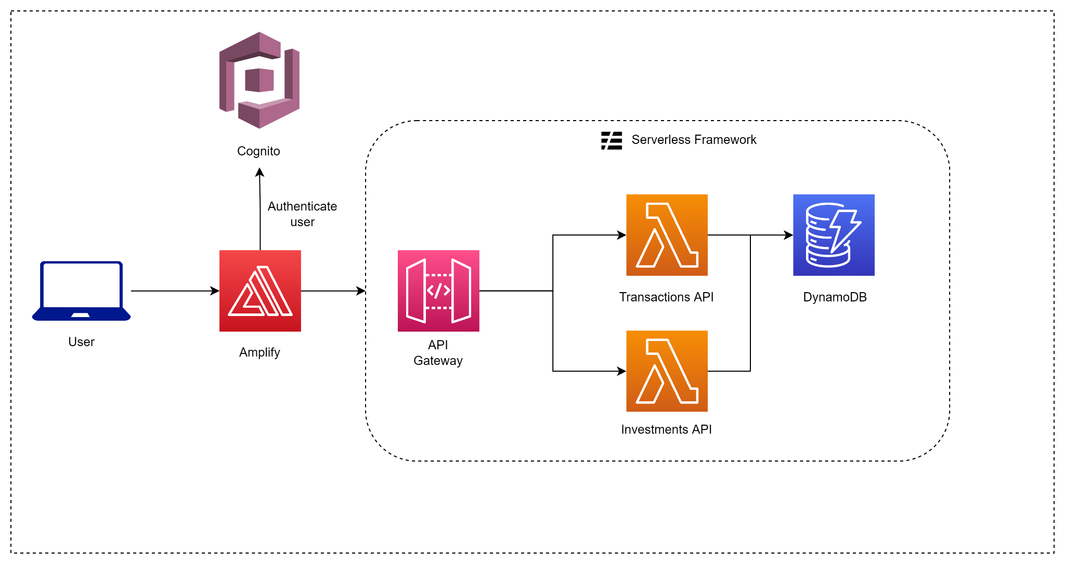
TECHNICAL ARCHITECTURE

Slide 22
Demo

Slide 23
Thank you!
Q&A

